Slide 1




DEPI Software Testing Project
Comprehensive Manual, API, and Automated UI Testing Framework
Coursera Website

Slide 2
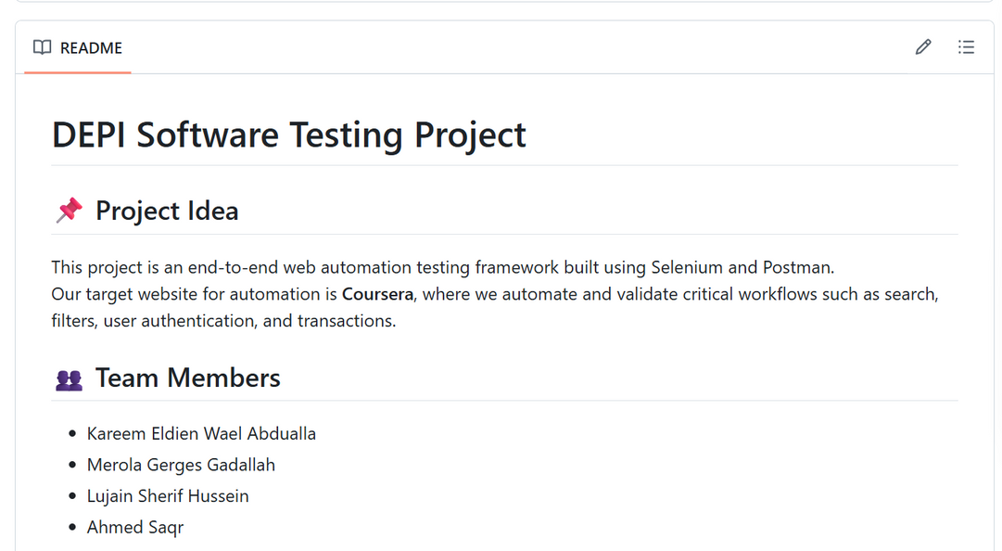
01
Team Members
Kareem Eldien Wael
Lujain Sherif Hussein
Merola Gerges Gadallah
Ahmed Saqr
Github link

Slide 3
02
Documentation
Project Requirements, Scope, Roles & Description documents
1
Test Plan, Test Cases (manual + automation + API) files present
2
3
Bug reports

Slide 4
Manual Testing
03
Authentication: login
Search: keyword search and suggestions
Filters: level / skills / language
Course page: details, instructor, reviews
Enrollment flow: Join / enroll navigation checks
UI/navigation: header/footer, responsiveness checks
Homepage & Static Pages: homepage elements, About / Careers / Help static pages (added to manual suite)
Negative tests: invalid login, empty inputs
Course Page: course details, instructors, reviews
User Profile Page: profile info, edit navigation, visibility checks

Slide 5
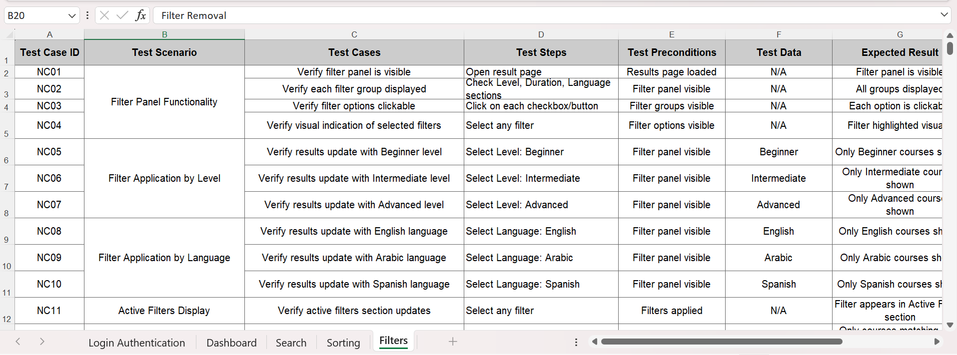
04

Slide 6
05
Automation Testing
Search automation: enter term → validate results
Filters automation: apply filter → validate list
Authentication checks: login validation (valid/invalid)
Course navigation → enrollment navigation validation
External-links automation: footer and static links (About, Help, Enterprise, other external redirects)
Navigation flows: home → course → back
Course Details Automation → navigate to course, validate course-info elements
User Profile Automation → navigate to profile, validate profile elements

Slide 7
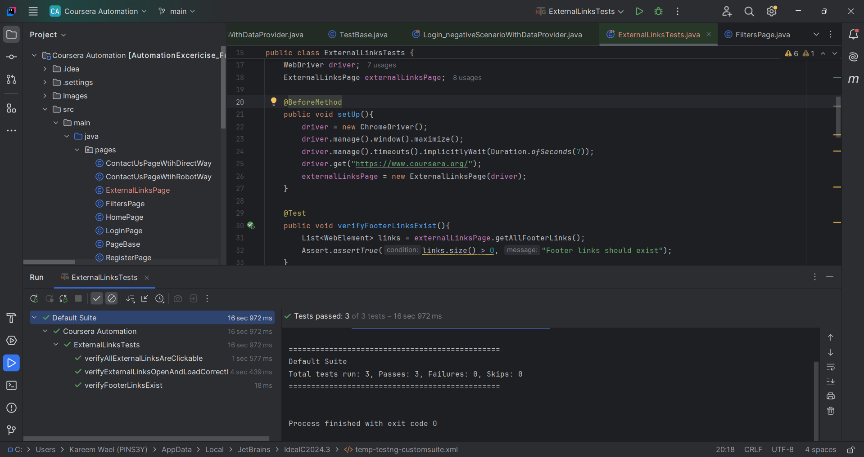
06

Slide 8
07
API testing (Postman)
Course Search API: requests + response validation
Course Listing API: response checks, status codes, response times
Postman collection & test scripts available in repo (API test artifacts present)

Slide 9
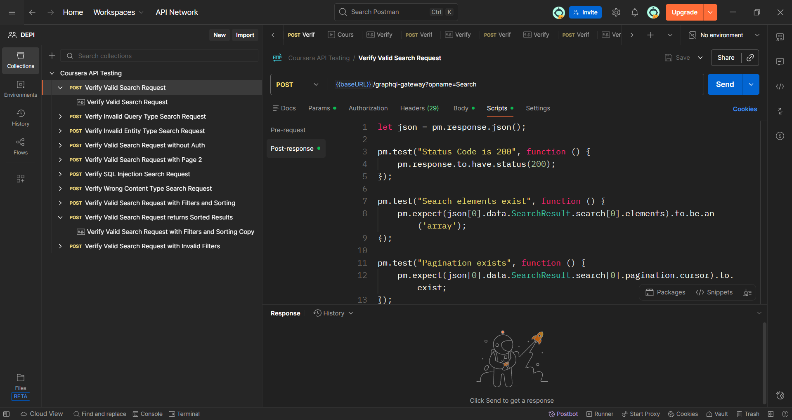
08

Slide 10
Thank You

